Slide 1
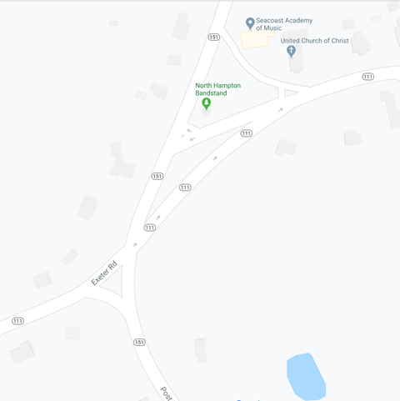
NH 111 & NH 151 Intersection Redesign in North Hampton, NH
A Civil Engineering Senior Capstone Project
Group: Liam Cullinane, Melissa Lyford, Michael Menary, Bill Nguyen

Slide 2
Project Goal: Improve both traffic and pedestrian safety and access in the NH111-NH151 intersection.
*This project is provided as part of the requirements for the Civil Engineering course CEE 797, Project Planning and Design, at the University of New Hampshire. It does not constitute a professional engineering design nor a professional land-surveying document. Although the information is intended to be accurate, students, instructors, and the University of New Hampshire make no claims, promises, or guarantees about the accuracy, completeness, or adequacy of the information. The user of this document shall ensure that its use does not violate New Hampshire law with regard to professional licensing and certification requirements, including any work resulting from this student-prepared document required to be under the responsible charge of a licensed engineer or surveyor.

Slide 3
Agenda
Summary of November Presentation
Feedback
Grading Categories
Redesign Alternatives Developed
Comparisons of Each Idea
Quick Survey
Open Question Time
March 9, 2020
*Please Hold All Questions Until Open Discussion at the End

Slide 4
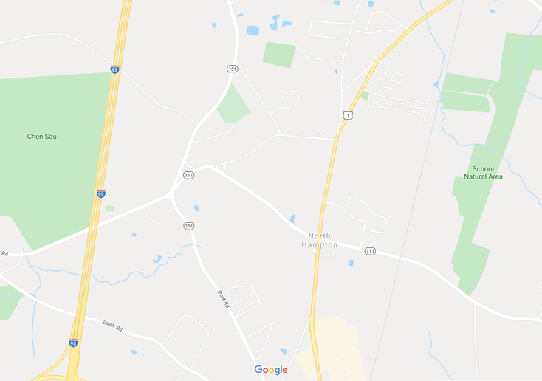
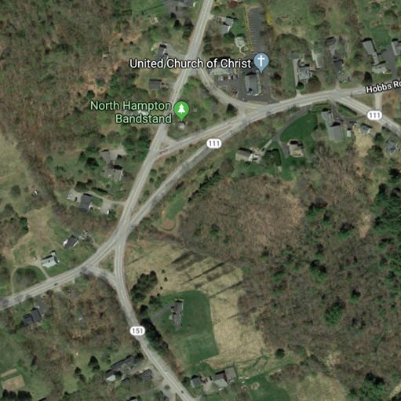
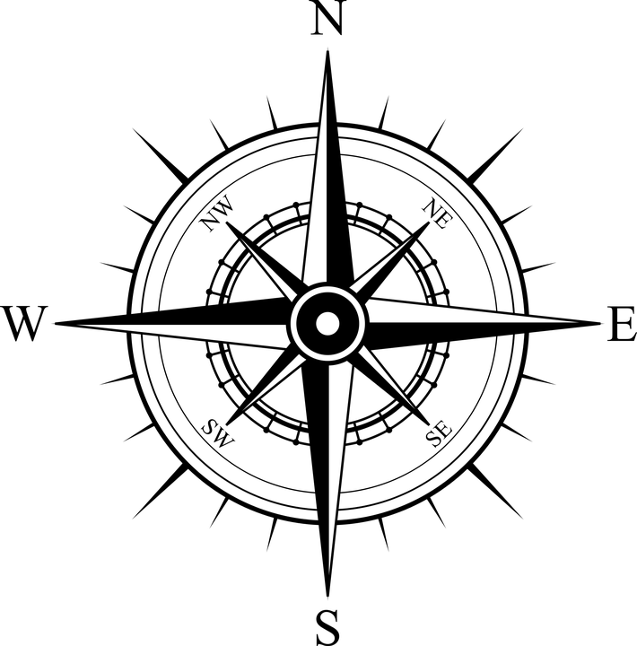
Aerial View of Intersection
Screen grabs from

Slide 5
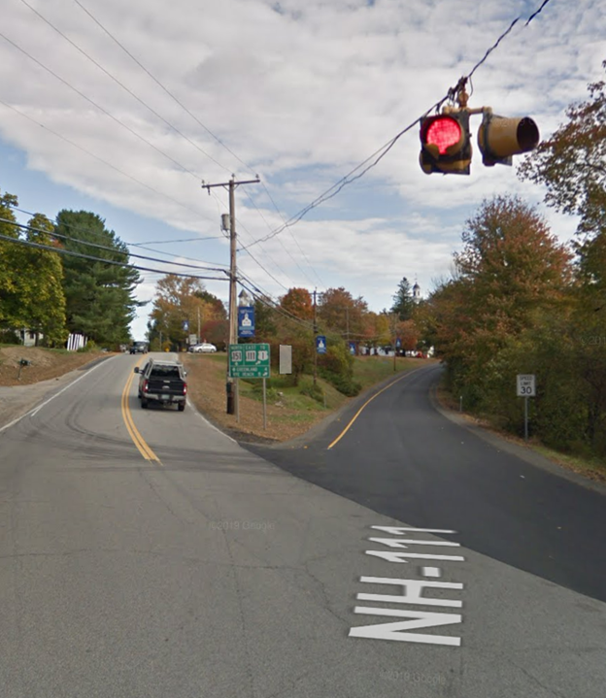
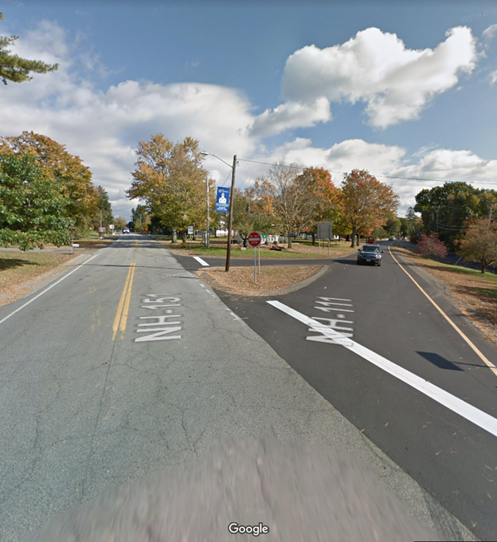
Current Conditions:
8 Separate Intersections
Skewed Crossing Angles
High Traffic Volumes
No Pedestrian Access
Significant Grade Changes
Historical Buildings
Note: Facing North, Looking at NH 151(left) - NH 111E(Right) Intersection from middle of road.
Note: In middle of road, facing North and looking at NH 151(left) - NH 111W(right) Intersection.
Screen grabs from

Slide 6
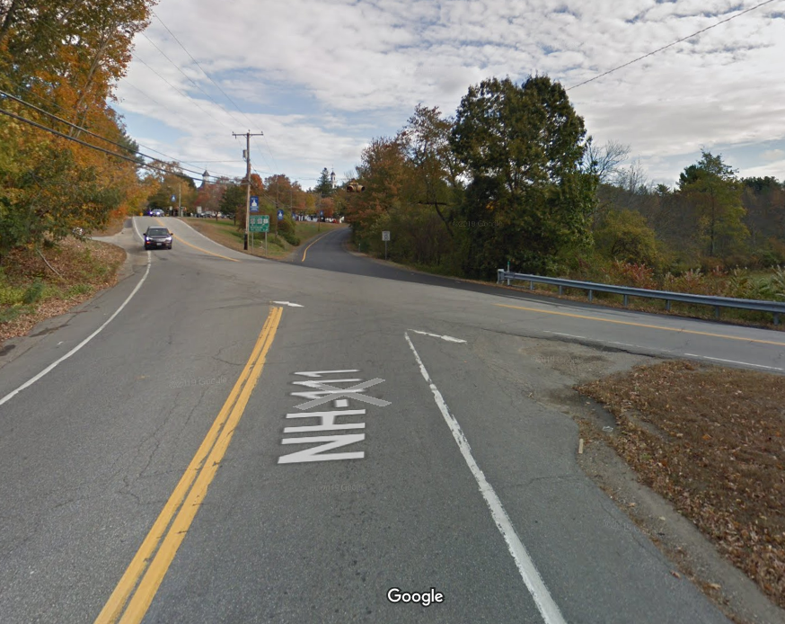
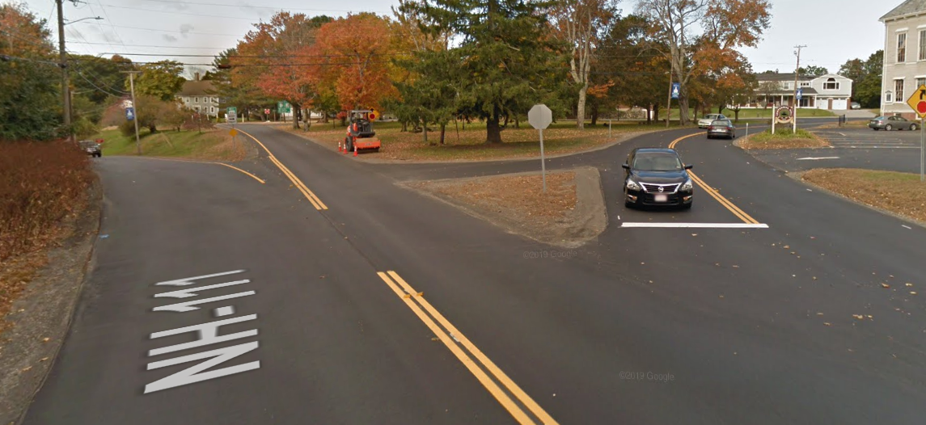
Problems Addressed Last Meeting:
1
“People don’t stop at the stop sign going East on NH 111”
1. Lower, Main Intersection
Skewed stopping angle (NH 111)
Low sight distance (111/151)
Uncontrolled Traffic (NH 151)
2. Intersection by Church
Poor Visibility
Confusing one-ways
2
Screen grabs from

Slide 7
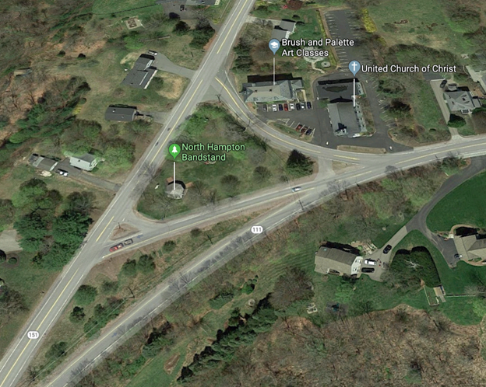
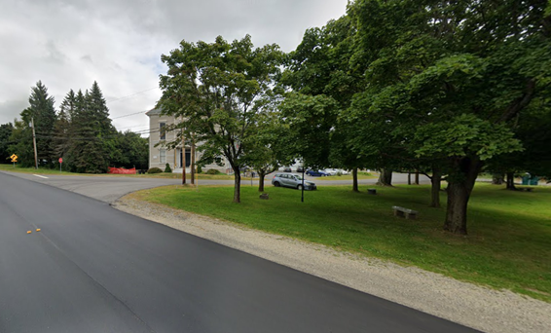
Problems Cont.
3
“Walk in people’s yards to avoid the cars while going to the bandstand”
3. Pedestrian Access
No sidewalks, crosswalks
4. Parking
Limited available parking for Bandstand Events
“People park on the grass or on the side of the road during bandstand events”
4
Screen grabs from

Slide 8
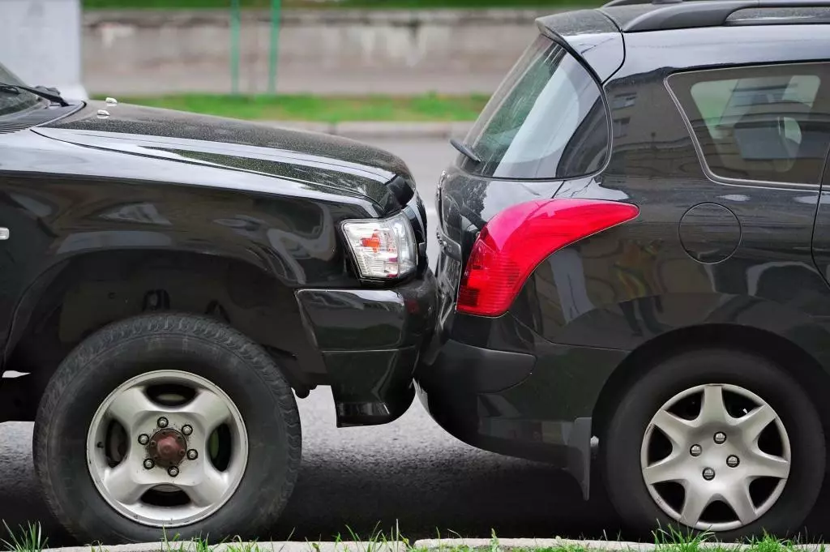
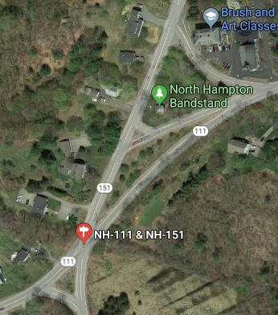
Feedback
Parking Concerns for Bandstand Events
- Members of Select Board and Residents
Concern for Fender Benders if NH151 is Forced to Slow/ Stop
- North Hampton Police Officer
Support for a Roundabout
- Residents at Last Select Board Meeting and by Email
Need Sidewalks for Bandstand Events
https://www.google.com/search?q=fender+bender&rlz=1C1GCEV_enUS891&sxsrf=ALeKk00ZdF68Sep2BLwC4Bu-vAPmUpBYkA:1583783901866&source=lnms&tbm=isch&sa=X&ved=2ahUKEwjZlvzmlo7oAhVsnuAKHUQtDywQ_AUoAXoECA4QAw&biw=1920&bih=937#imgrc=LOCDVBdqE6SqeM
Screen grabs from

Slide 9
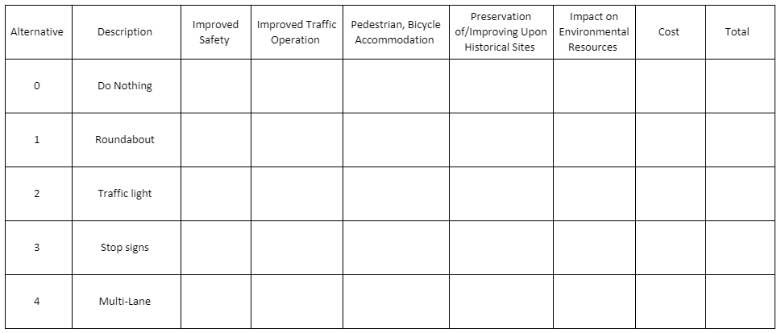
Alternatives Grading Criteria
Safety
Traffic Operation
Pedestrian, Bicycle Access
Historical Sites
Environmental Impact
Cost

Slide 10
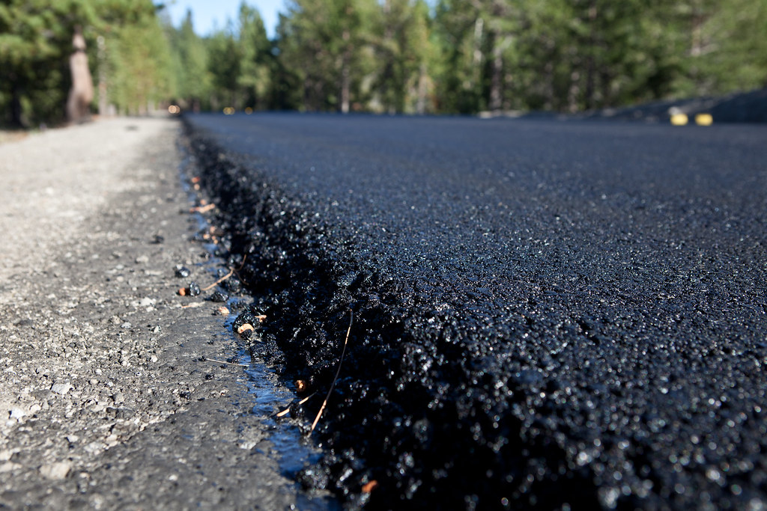
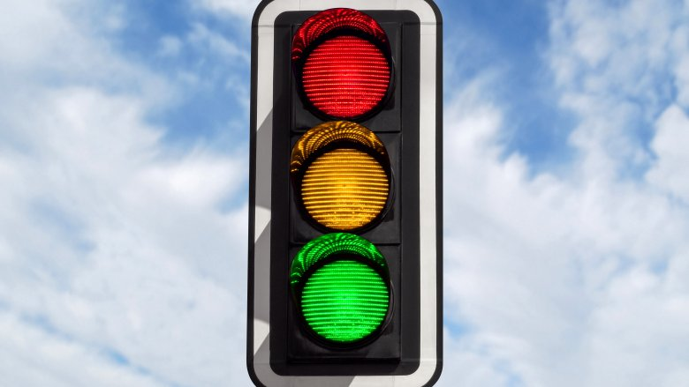
Cost
Materials
Construction & Assembly
Road Demolition & Removal
Added Pavement Area
Traffic Lights & Signage

Slide 11
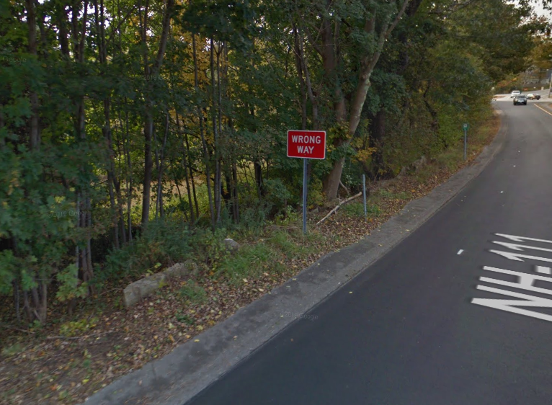
Environmental Impact
New Areas of Paved Road versus Removed Road
Road Encroachment on Wetlands
Screen grab from

Slide 12
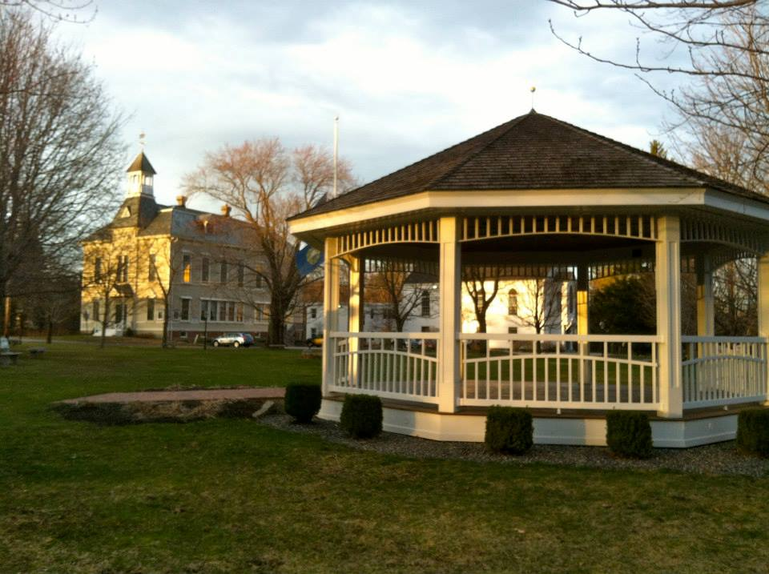
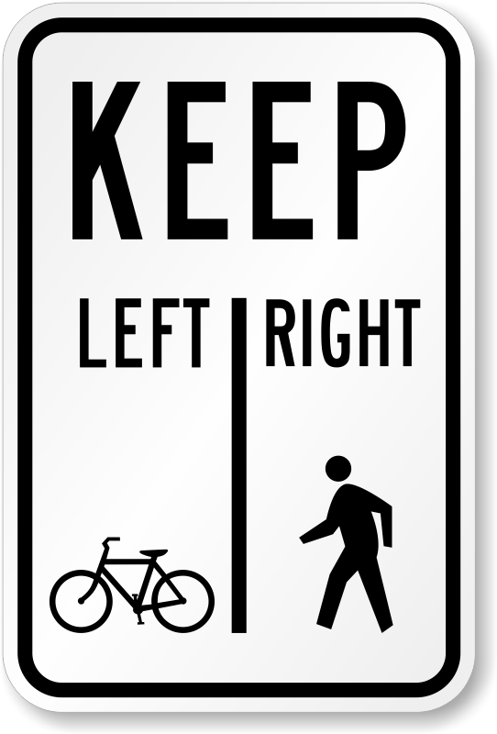
Pedestrian, Bicycle Accommodation
Preserving Historical Sites
Simply a Yes or No question, does the alternative accommodate both pedestrian and bicycle access to and around the intersection?
Simply a Yes or No question, does the alternative affect the current historical site, North Hampton Bandstand?
https://www.roadtrafficsigns.com/bike-sign/pedestrians-right-bicycles-left-sign/sku-x-r9-7.aspx
https://patch.com/new-hampshire/hampton-northhampton/north-hampton-tree-lighting

Slide 13
Safety
What do we mean by safety?
Projected crashes
Points of conflict
Simplification of Intersection
https://www.nh.gov/dot/org/projectdevelopment/highwaydesign/roundabouts/documents/FHWARoundaboutBrochure.pdf

Slide 14
Traffic Operation
Does the improved intersection reduce congestion and encourage traffic flow?
Level of Service: used to analyze roadways and intersections by categorizing traffic flow based on performance measures
Vehicle speed
Density
Congestion
https://images.roadtrafficsigns.com/img/lg/K/Roundabout-Ahead-With-Graphic-Sign-K-8273.gif
https://images.roadtrafficsigns.com/img/md/X/Traffic-Light-Ahead-Sign-X-W3-3.gif
https://images.roadtrafficsigns.com/img/lg/X/stop-ahead-sign-x-w3-1.png

Slide 15
Our Design Alternatives

Slide 16
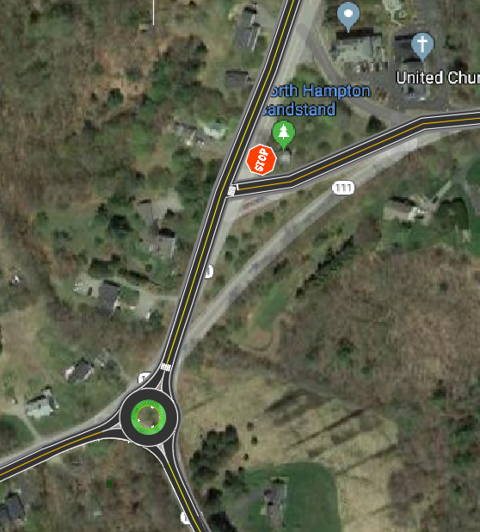
Alternative #1: Roundabout
Roundabout Built in Main Intersection
Combined 1-ways into a 2-way by Bandstand
Optional Removal of Centennial Hall Road & Added Parking Lot
Safety: Tied for #2 of 5 Options, Allows NH 111 Traffic to Flow more Freely, Slows NH 151 Drivers Down, May Increase NH 151 Rear Ends
Traffic Operation: 2nd Best Option, Gives West Bound NH111 Drivers Same Opportunity to Travel Through Intersection as NH151
Pedestrian, Bicycle Accommodation: Yes, Both
Preservation of/Improving Upon Historical Sites: No interference, allows for additional parking space
Impact on Environmental Resources: 1-way Adjacent to Wetlands Removed
Cost: Roughly $192,400 2nd Most Expensive

Slide 17
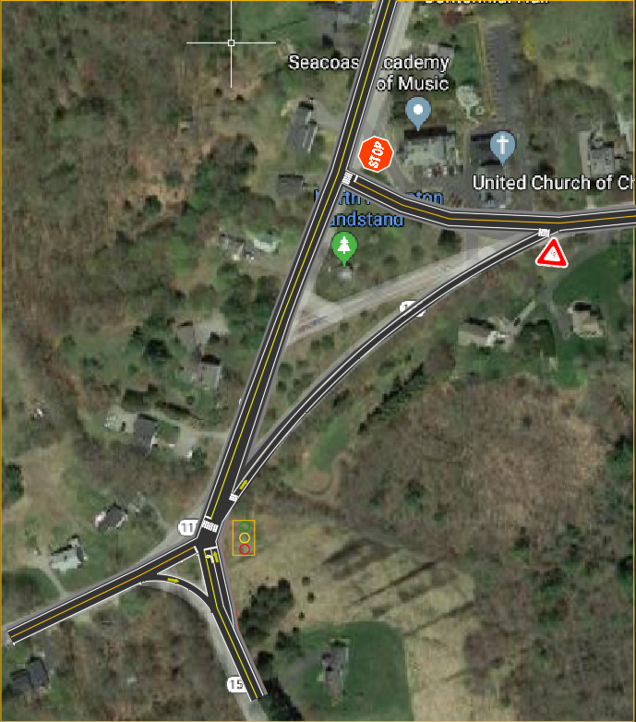
Alternative #2: Traffic Light
Traffic Light at Main Intersection
Remove Westbound NH111 1-way, Leave Eastbound 1-way
Reconfigure connecting road between Bandstand and Hall
Safety: Ranked #4 of 5 Options, Better than Doing Nothing
Eliminates Risky Crossings from NH111 Driving East across NH151
Traffic Operation: Tied for #1 of 5 Options, Allows for more Continuous flow
Pedestrian, Bicycle Accommodation: Yes, Both
Preservation of/Improving Upon Historical Sites: No interference, allows for additional parking space
Impact on Environmental Resources: Additional Electric lines may be required
Cost: Roughly $162,800 3rd Most Expensive

Slide 18
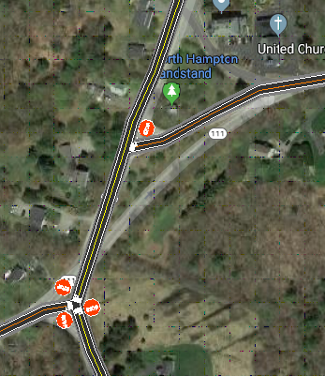
Alternative #3: Stop Signs
Create 3-way Stop at Main Intersection
Combine 1-ways and Centennial Hall Road into one 2-way
Remove Centennial Hall Road & Add Parking Lot
Safety: Safest Option, Forces All Cars to Slow Down
Traffic Operation: Worst of 5 Options
Pedestrian, Bicycle Accommodation: Yes Both
Preservation of/Improving Upon Historical Sites: No interference, allows for additional parking space
Impact on Environmental Resources: 1-way Adjacent to Wetlands Removed
Cost: Roughly $139,500 Least Expensive Alternative

Slide 19
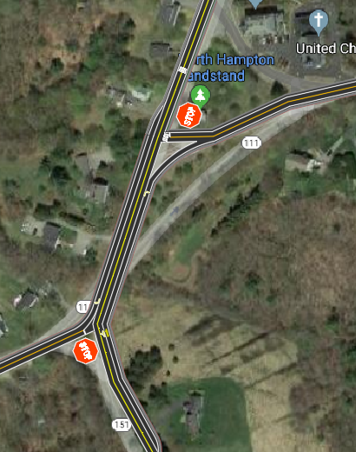
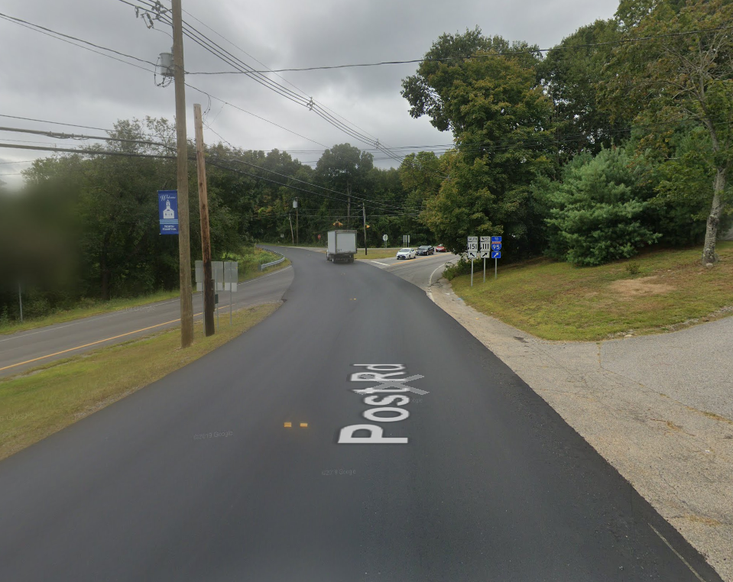
Alternative #4: Multi-Lane
Combine 1-ways into a 2-way
Add another lane to each side of NH 151 between intersections
Removing of Centennial Hall Road & Adding Parking Lot
Safety: Tied for #2 of 5 Options
Traffic Operation: Tied for #1 of 5 Options
Pedestrian, Bicycle Accommodation: Worst Accomodation, Tough to Fit Everything in with 4 Lanes, Also Tough to Cross a 4-Lane Road
Preservation of/Improving Upon Historical Sites: No interference, allows for additional parking space
Impact on Environmental Resources: 1-way Adjacent to Wetlands Removed
Cost: Roughly $378,100 Most Expensive
Screen grabs from
NH 151 Southbound, view just below Upper intersection.

Slide 20
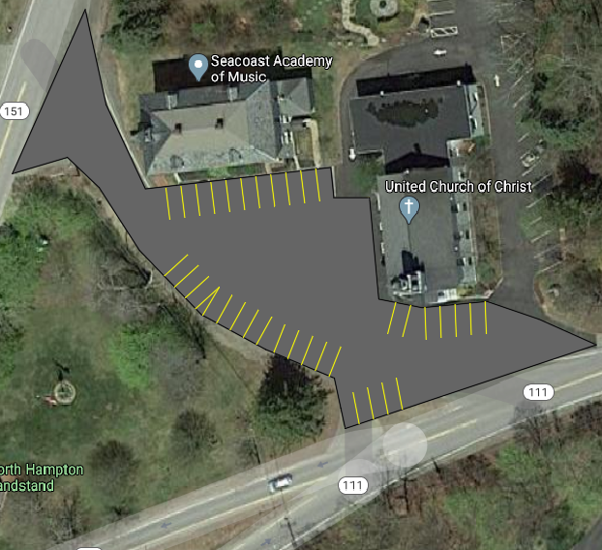
Optional Parking Idea
Brainstormed by the group, suggested by multiple people
Remove Centennial Hall Road
Install Parking lot that combines with the existing Centennial Hall and Church Lots
Can Add up to 19 More Spots
Cost: $113,300

Slide 21
Addressing Feedback/Ideas
Feedback: There is barely any parking for bandstand events.
Response: Eliminate connector road separating Bandstand & Centennial Hall
Feedback: Slowing Down NH151 with a Roundabout or Traffic Light will cause More Rear-End Crashes
Response:
Crashes Here Specifically Have a 37% Chance of Injury
“Side impact car accidents kill between 8,000 and 10,000 people each year, more than rear-end and head-on collisions combined” (Fernandez)
Can Invest in Signs or Speed Bumps for Cars Going South on NH151/Post Rd
“Roundabout Ahead” Sign -$300
LED Flashing Sign -$900
*Fernandez, Stephen. “The Effects of Side Impact Car Crashes on the Body.” JusticePays.com, www.justicepays.com/learning/crash-science/the-effects-of-side-impact-car-crashes-on-the-body.

Slide 22
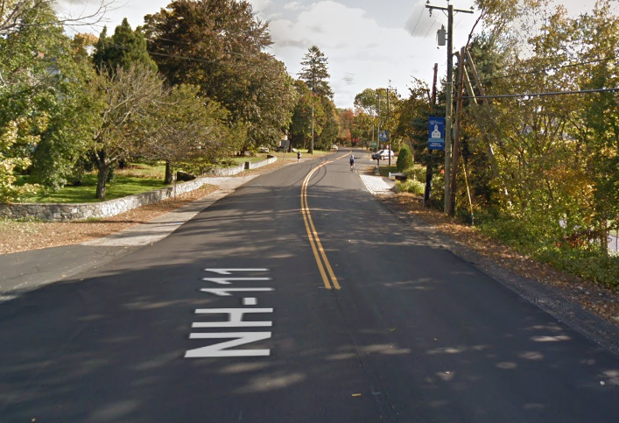
Addressing Feedback/Ideas
Feedback: “I have to walk on peoples lawns to reach the bandstand events.”
Response: Can Install Sidewalks Around the Area
*Problem is, there are no sidewalks remotely close to the intersection, would be up to the town to decide how far the bandstand the sidewalks would reach.

Slide 23
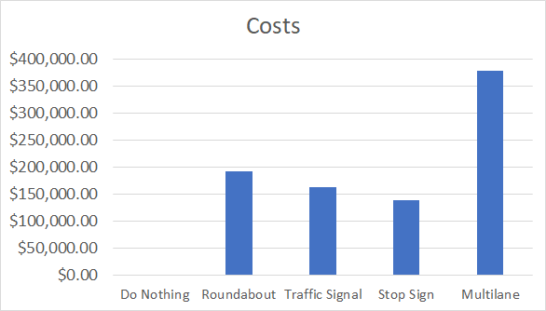
Cost, $$$: Estimated using Engineering Economics

Slide 24
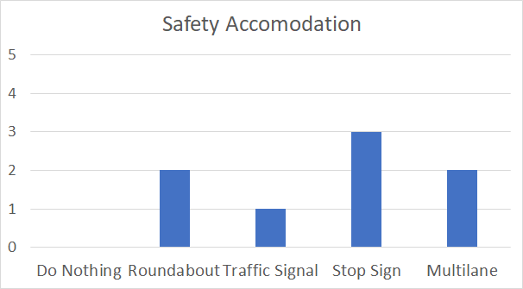
Safety: Decrease in Potential Crashes

Slide 25
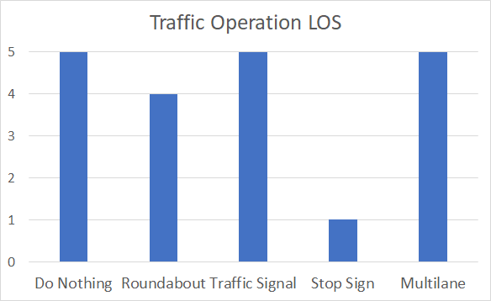
Traffic Operation: Speed Limit Level of Service

Slide 26
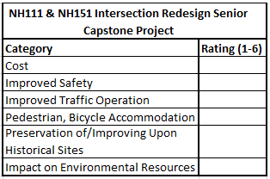
Of the Categories Listed, Please Rank Your Priorities:
Safety
Traffic Operation, Flow
Pedestrian, Bicycle Accommodation
Historical Sites Preservation
Environmental Impact
Cost
* 1 being the Most Important
* 6 being the Least

Slide 27
If You Are Reading This PowerPoint From Home, Please Take the Survey Here:
https://www.surveymonkey.com/r/D66F3TD

Slide 28
Questions/Comments on Ideas

Slide 29
Thank You!
If you have any more questions, comments, or concerns please email:
lmc1035@wildcats.unh.edu

