Slide 1
TOWN OF NORTH HAMPTON 2021 DELIBERATIVE SESSION
Moderator
Bobbi Burns
Select Board
Jim Maggiore, Chair
James Sununu, Vice Chair
Larry Miller, Member
Michael Tully, Town Administrator
February 6, 2021

Slide 2
Article One: Election of Officers
To choose the following officers for the coming year:
1 Select Board Member, 3 year term;
1 Town Treasurer, 1 year term;
1 Library Trustee, 3 year term;
2 Budget Committee Members, 3 year terms each;
1 Trustee of the Cemeteries, 3 year term;
2 Planning Board Members, 3 year terms each;
2 Water Commissioners, 3 year terms each;
1 Zoning Board Member, 3 year term;
1 Trustee of the Trust Funds, 3 year term;

Slide 3
Article Two: Amendment to Zoning Ordinance – Yard and Lot Requirements and Accessory Structures
Are you in favor of the adoption of Amendment Number 1 to the Zoning Ordinance as proposed by the Planning Board as follows:
To amend Section 203.1 Yard and Lot Requirements and Section 301 Accessory Structures. The intent of the proposed amendment is to:
a. Clarify that relief from size and setback requirements for accessory structures is granted through the issuance of a Conditional Use Permit from the Planning Board, not a variance from the Zoning Board of Adjustment; and
b. Add required front setback distance for accessory structures.
Majority Ballot Vote Required.
Recommended by the Planning Board: 5-0

Slide 4
Article Three: Amendment to Zoning Ordinance – Aquifer Protection District
Are you in favor of the adoption of Amendment Number 2 to the Zoning Ordinance as proposed by the Planning Board as follows:
To amend Section 503 Aquifer Protection District Ordinance. The intent of the proposed amendment is to:
a. Expand the Aquifer Protection District boundaries to include aquifer areas defined by US Geological Survey (USGS) Water Resources Investigations Report for Lower Merrimack and Coastal River Basins, Southeastern New Hampshire and Public Water Supply Wellhead Protection areas;
b. Provide definitions for public water system and wellhead protection area and include these areas within the Aquifer Protection District; thereby providing increased protection against contamination for these areas;
c. Allow the Planning Board to determine the need for a hydrogeologic study on a case-by-case basis, as opposed to the current provision requiring a hydrogeologic study for all development proposals within the Aquifer Protection District; and
d. Require a Conditional Use Permit for an activity that does not comply with the provisions of the aquifer ordinance.
Majority Ballot Vote Required.
Recommended by the Planning Board: 6-0

Slide 5
Article Four: Amendment to Zoning Ordinance – Definitions and Industrial-Business/Residential District
Are you in favor of the adoption of Amendment Number 3 to the Zoning Ordinance as proposed by the Planning Board as follows:
To amend Section 104 Definitions and Section 202.4 Industrial-Business/Residential District. The intent of the proposed amendment is to add a definition for self-storage facility and require that self-storage facility use only be allowed in the Industrial-Business/Residential District with the issuance of a special exception.
Majority Ballot Vote Required.
Recommended by the Planning Board: 7-0

Slide 6
Article Five: FY 2022 Operating Budget
To see if the Town will vote to raise and appropriate through taxation as an operating budget, not including appropriations by special warrant articles and other appropriations voted separately, the amounts set forth on the budget posted with the warrant or as amended by vote of the first session, for the purposes set forth therein, Seven Million Six Hundred Eighty-two Thousand Three Hundred Thirteen Dollars ($7,682,313)? Should this Article be defeated, the default budget shall be Seven Million Seven Hundred Seventy-four Thousand One Hundred Fifty-eight Dollars ($7,774,158), which is the same as last year, with certain adjustments required by previous action of the Town or by law, or the governing body may hold one special meeting, in accordance with RSA 40:13, X and XVI, to take up the issue of a revised operating budget only.
Majority Ballot Vote Required.
Recommended by the Select Board: 3-0
Recommended by the Budget Committee: 8-1

Slide 7
Article Five: FY 2022 Operating Budget
FY 2021 Operating Budget: $ 7,426,422
FY 2022 Operating Budget: $ 7,682,313
$ Increase FY 21 to FY 22 Operating $ 255,891
% Increase FY 21 to FY 22 Operating 3.446%
FY 2021 Operating Budget: $ 7,426,422
FY 2022 Default Budget: $ 7,774,158
$ Increase FY 21 to FY 22 Default $ 347,736
% Increase FY 21 to FY 22 Default 4.682%

Slide 8
Article Five: FY 2022 Operating Budget
Changes FY 21 to FY 22 Operating:
Executive $ (5,001)
- Reduction in salaries, FICA/Medicare, community newsletter, and training & education, partially offset by an increase in meeting minutes, retirement contributions, telephone/internet/cable, and office supplies.
Town Clerk/Elections $ 4,714
- Increase in salaries, FICA/Medicare, retirement contributions, registration expenses, recording fees, and postage, partially offset by a reduction in telephone/internet/cable, supplies, and election meals.
Financial Administration $ 7,302
- Increase in salaries, FICA/Medicare, retirement contributions, and bank service charges/finance charges.

Slide 9
Article Five: FY 2022 Operating Budget
Data Processing $ 4,000
- Increase in licenses/contract services and monthly billing from the IT contractor.
Property Valuation $ (1,760)
- Reduction in contract assessing services.
Personnel Administration $ 24,628
- Increase in the cost of health insurance due to changes in demographics, partially offset by a reduction in compensation/salary increases used for annual performance evaluations.
Planning and Zoning $ 6,219
- Increase in salaries, FICA/Medicare, and retirement contributions.

Slide 10
Article Five: FY 2022 Operating Budget
General Government Buildings $ (2,480)
- Reduction in custodial salary, FICA/Medicare, heating oil/propane, and water, partially offset by an increase in electricity and custodial supplies.
Cemeteries $ 238
- Increase in FICA/Medicare, heating oil/propane, and office supplies.
Insurance $ (9,325)
- Reduction in workers’ compensation, term life insurance and long- term disability and short-term disability insurance, partially offset by an increase in property & liability insurance,.
Associations and Advertising $ (186)
-Reduction in New Hampshire Municipal Association dues.

Slide 11
Article Five: FY 2022 Operating Budget
Police $ 99,224
- Increase in overtime, retirement contributions, health insurance, training & education, dues/subscriptions & notices, books & periodicals, and station maintenance/lock up & breathalyzer partially offset by a reduction in salaries, FICA/Medicare, vehicle maintenance, office supplies, supplies/crime prevention, and equipment.
Fire and Rescue $ 34,298
- Increase in retirement contributions, health insurance, training, telephone/internet/cable, dues/subscriptions & notices, and vehicle maintenance, partially offset by a reduction in salaries, overtime, FICA/Medicare, education, physicals & drug/polygraph screening, equipment and equipment maintenance, radio maintenance, and gasoline/mileage/tolls.

Slide 12
Article Five: FY 2022 Operating Budget
Code Enforcement $(20,658)
- Reduction in salaries, FICA/Medicare, training & education, telephone/internet/cable, and gas/mileage/tolls, partially offset by an increase in retirement contributions.
Emergency Management $ 583
- Increase in retirement contributions and training overtime.
Highways and Streets $ 5,773
- Increase in salaries, FICA/Medicare, retirement contributions, telephone/internet/cable, contract snow plowing, catch basin cleaning, pavement marking, uniforms, gasoline/mileage/tolls, and equipment, partially offset by a reduction in health insurance, training & education, care of trees, electricity, propane/natural gas, equipment lease payments, dues/subscriptions & notices, equipment maintenance, equipment rental, street signs, and asphalt paving & repairs.

Slide 13
Article Five: FY 2022 Operating Budget
Street Lighting $ (5,000)
- Reduction consistent with anticipated spending after the installation of additional LED lighting fixtures throughout the Town.
Brush Disposal $ 232
- Increase in salaries and FICA/Medicare.
Solid Waste Disposal $ 9,000
- Increase in solid waste disposal tipping fees, bulky waste disposal fees, and solid waste disposal district dues.
Recycling $ 1,422
- Increase in salaries, FICA/Medicare, hauling services, and portable toilet rental.

Slide 14
Article Five: FY 2022 Operating Budget
Mosquito Control $ (1,350)
- Reduction consistent with historical spending.
Parks and Recreation $ 1,051
- Increase in salaries, FICA/Medicare, and retirement contributions, partially offset by a reduction in advertising, training & education, Dearborn Park maintenance, and senior activities.
North Hampton Public Library $(24,215)
- Reduction in salaries, FICA/Medicare, retirement contributions, and health insurance, partially offset by an increase in programs, operations & supplies, utilities, maintenance, and media.
Patriotic Purposes $ (1,000)
- Reduction consistent with prior year spending.

Slide 15
Article Five: FY 2022 Operating Budget
Economic Development Committee $ (999)
- Reduction in funding for surveys regarding economic development.
Debt Service - Principal $ 66,025
- Scheduled increase in principal debt service.
Debt Service - Interest $ 63,156
- Scheduled increase in interest debt service.
Total Change in Operating Budget $255,891

Slide 16
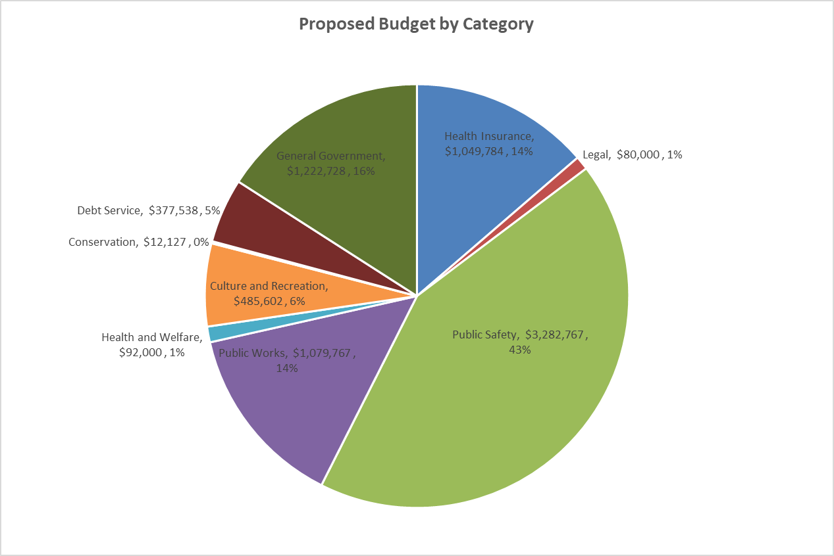
Article Five: FY 2022 Operating Budget

Slide 17
Article Six: Proposed Fire Department Collective Bargaining Agreement
To see if the Town will vote to approve the cost items included in a three-year collective bargaining agreement reached between the Select Board and the International Fire Fighters Association Local 3211 which calls for the following increases in salaries, fringe and other cost items at the current staffing level:
And further, to see if the Town will vote to raise and appropriate through taxation the sum of Twenty-four Thousand Two Hundred Forty-three Dollars ($24,243) for Fiscal Year 2022? Said sum representing the additional costs attributable to the increase in salaries, fringe and other cost items required in year one of the new agreement over those that would be paid at current staffing levels under the existing agreement.
Majority Ballot Vote required
Recommended by the Select Board: 3-0
Recommended by the Budget Committee: 6-0
Fiscal Year | Total of Cost Items | Estimated Increase
2022 | $1,456,727 | $24,243
2023 | $1,515,627 | $3,103
2024 | $1,607,419 | $4,380

Slide 18
Article Seven: Lease Purchase of DPW Medium Duty Truck
To see if the Town will vote to authorize the Select Board to enter into a five-year lease/purchase agreement in the amount of Ninety Thousand Dollars ($90,000) for the purpose of leasing and equipping a medium duty truck for the Department of Public Works; and to raise and appropriate through taxation the sum of Eighteen Thousand Dollars ($18,000) for the first year’s payment on said lease. This lease agreement contains a fiscal funding (escape) clause. This item has been identified in the approved Capital Improvements Plan.
Majority Ballot Vote required.
Recommended by the Select Board: 3-0
Recommended by the Budget Committee: 4-3

Slide 19
Article Eight: Purchase of an Automated Fingerprint Scanner
To see if the Town will vote to raise and appropriate through taxation the sum of Fifteen Thousand Dollars ($15,000) for the purchase of an automated fingerprint scanner. The Police Department has an antiquated fingerprinting system and the automated scanner will eliminate the labor-intensive work, prevent mix-ups and allow touchless printing. This item has been identified in the approved Capital Improvements Plan.
Majority Ballot Vote required.
Recommended by the Select Board: 3-0
Recommended by the Budget Committee: 7-0

Slide 20
Article Nine: Road Resurfacing
To see if the Town will vote to raise and appropriate the sum of Two Hundred Forty Thousand Dollars ($240,000) for the purpose of resurfacing and reconstructing approximately 3 miles of road, by withdrawing Thirty Thousand Dollars ($30,000) from the previously established Municipal Transportation Improvement Capital Reserve Fund created for this purpose, and raising through taxation Two Hundred Ten Thousand Dollars ($210,000)? This item has been identified in the approved Capital Improvements Plan.
Majority Ballot Vote required.
Recommended by the Select Board: 3-0
Recommended by the Budget Committee: 7-0

Slide 21
Article Ten: Paving at Recycling Center
To see if the Town will vote to raise and appropriate through taxation the sum of Thirty-three Thousand Dollars ($33,000) for the purpose of reconstructing and paving the driveway and material storage areas at the recycling center? This item has been identified in the approved Capital Improvements Plan.
Majority Ballot Vote required.
Recommended by the Select Board: 3-0
Recommended by the Budget Committee: 7-0

Slide 22
Article Eleven: Contribution to the Earned Time Settlement Capital Reserve Fund
To see if the Town will vote to raise and appropriate through taxation the sum of Twenty Thousand Dollars ($20,000) for deposit into the Earned Time Settlement Capital Reserve Fund? The purpose of this fund is to buy out employees earned time during anytime of the life of their career and limit the Town’s unfunded accrued leave liability. The total estimated liability for unfunded accrued leave is $319,510 of which $87,368 is anticipated to be payable prior to July 1, 2022. The balance in the Fund, as of December 31, 2020, is $92,044.
Majority Ballot Vote required.
Recommended by the Select Board: 3-0
Recommended by the Budget Committee: 7-0

Slide 23
Article Twelve: Contribution to the Coakley Landfill Capital Reserve Fund
To see if the Town will vote to raise and appropriate through taxation the sum of Seventy-five Thousand Dollars ($75,000) for deposit into the Coakley Landfill Capital Reserve Fund? The purpose of this fund is to account for any expenses incurred by the Town under the Superfund Cleanup Program. The balance in the Fund, as of December 31, 2020, is $154,479.
Majority Ballot Vote required.
Recommended by the Select Board: 3-0
Recommended by the Budget Committee: 7-0

Slide 24
Article Thirteen: Establish Town Land Environmental Remediation Capital Reserve Fund
To see if the Town will vote to establish a Capital Reserve Fund under the provisions of RSA 35:1 for the purpose of environmental remediation to Town owned land and costs related thereto, and to raise and appropriate through taxation the sum of Thirty-four Thousand Five Hundred Dollars ($34,500) for deposit into the Fund, and to name the Select Board as agents to expend from the Fund?
Majority Ballot Vote required.
Recommended by the Select Board: 3-0
Recommended by the Budget Committee: 7-0

Slide 25
Article Fourteen: Any Other Business
To see if the Town will transact any other business that may legally come before the Meeting.

Slide 26
Town Voting Day
Tuesday
March 9, 2021
8AM – 7PM
North Hampton
School

